Slide 1
Achieving supply chain efficiency and resilience by using multi-level commons
Single European Sky and Resilience in ATM, Sofia, Bulgaria
September 15, 2022
Based on joint work with
Sunil Chopra (Kellogg School of Management)
ManMohan Sodhi (Bayes Business School)
Dr Florian Lücker
Senior Lecturer in Supply Chain Management
Bayes Business School
florian.lucker@city.ac.uk

Slide 2
Supply Chain Management
Just-in-time supply chain
Focus on cost-reduction to create supply chain value
Used primarily for functional products such as consumer goods (where firms compete on price)
Supply chain managers aim to increase the efficiency of supply chains
Just-in-case supply chain
Focus on reducing the likelihood of supply chain breakdown
Used primarily for innovative products where there is less competition on price.
Supply chain managers aim to build resilience by using buffers such as inventory, capacity, multiple-sourcing, near-shoring
Supply chain efficiency, which is directed at improving a company’s financial performance, is different from supply chain resilience, whose goal is risk reduction.

Slide 3



Shared resources facilitate cost-efficient risk mitigation strategies
The main message of this talk is that shared resources (referred to as commons) can help companies build resilient and cost-efficient supply chains
The notion of commons derives from shared land in an English village to which all the people in the village have access for letting their sheep and
cattle graze.
Shared resources often provide a benefit to a company in times of absence of disruptions but also provides some resilience in the event of a disruption.

Slide 4


Example: Zara and H&M during COVID-19
The success of Zara was attributed to its omni-channel solution that allowed for selling products online during lock-downs.
The store is a common because it is used to serve offline and online demand.
Creating multiple flows of goods using shared resources helps firms build resilient and efficient supply chains
Zara experienced only a small decline in sales and profit.
H&M was badly hit by the lockdowns that prevented customers from shopping in the brick-and-mortar stores.

Slide 5
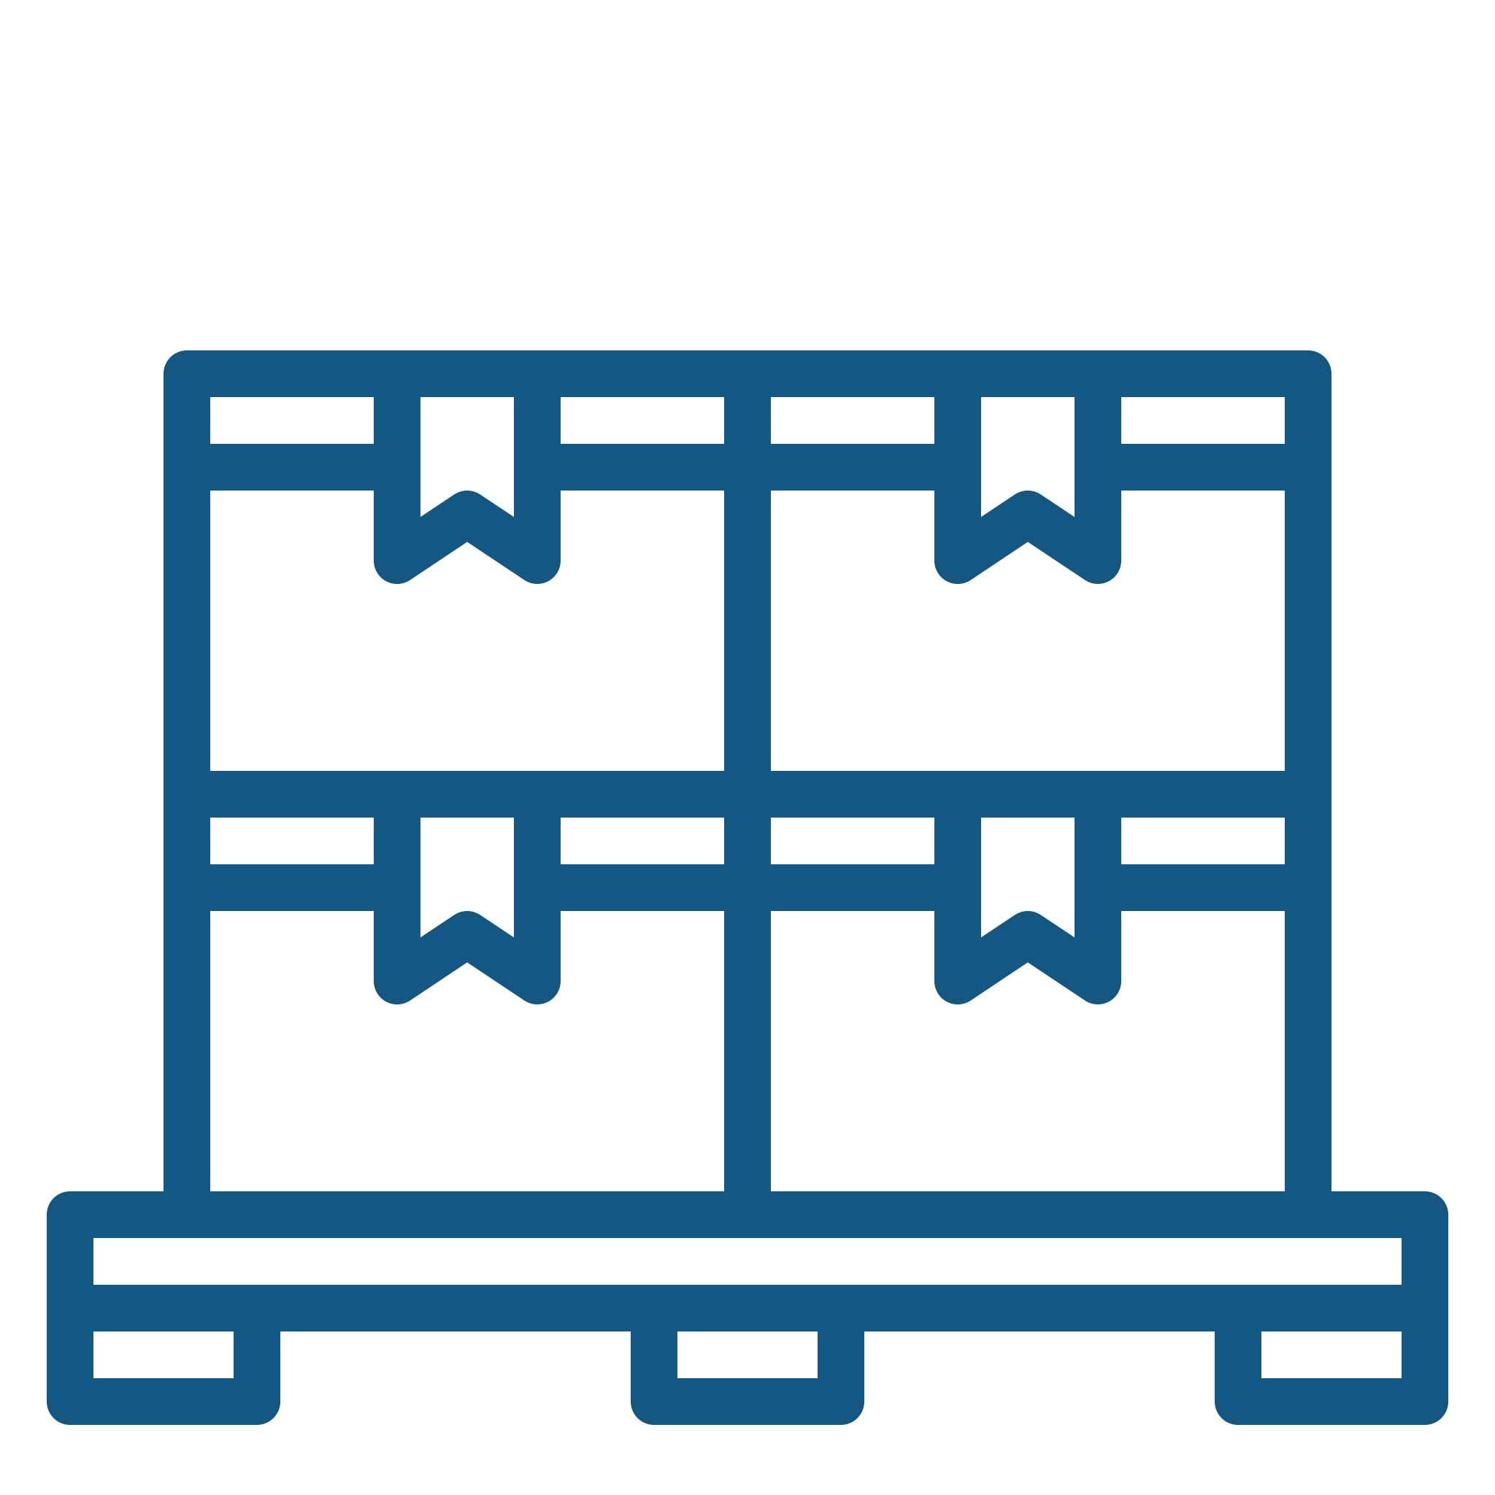
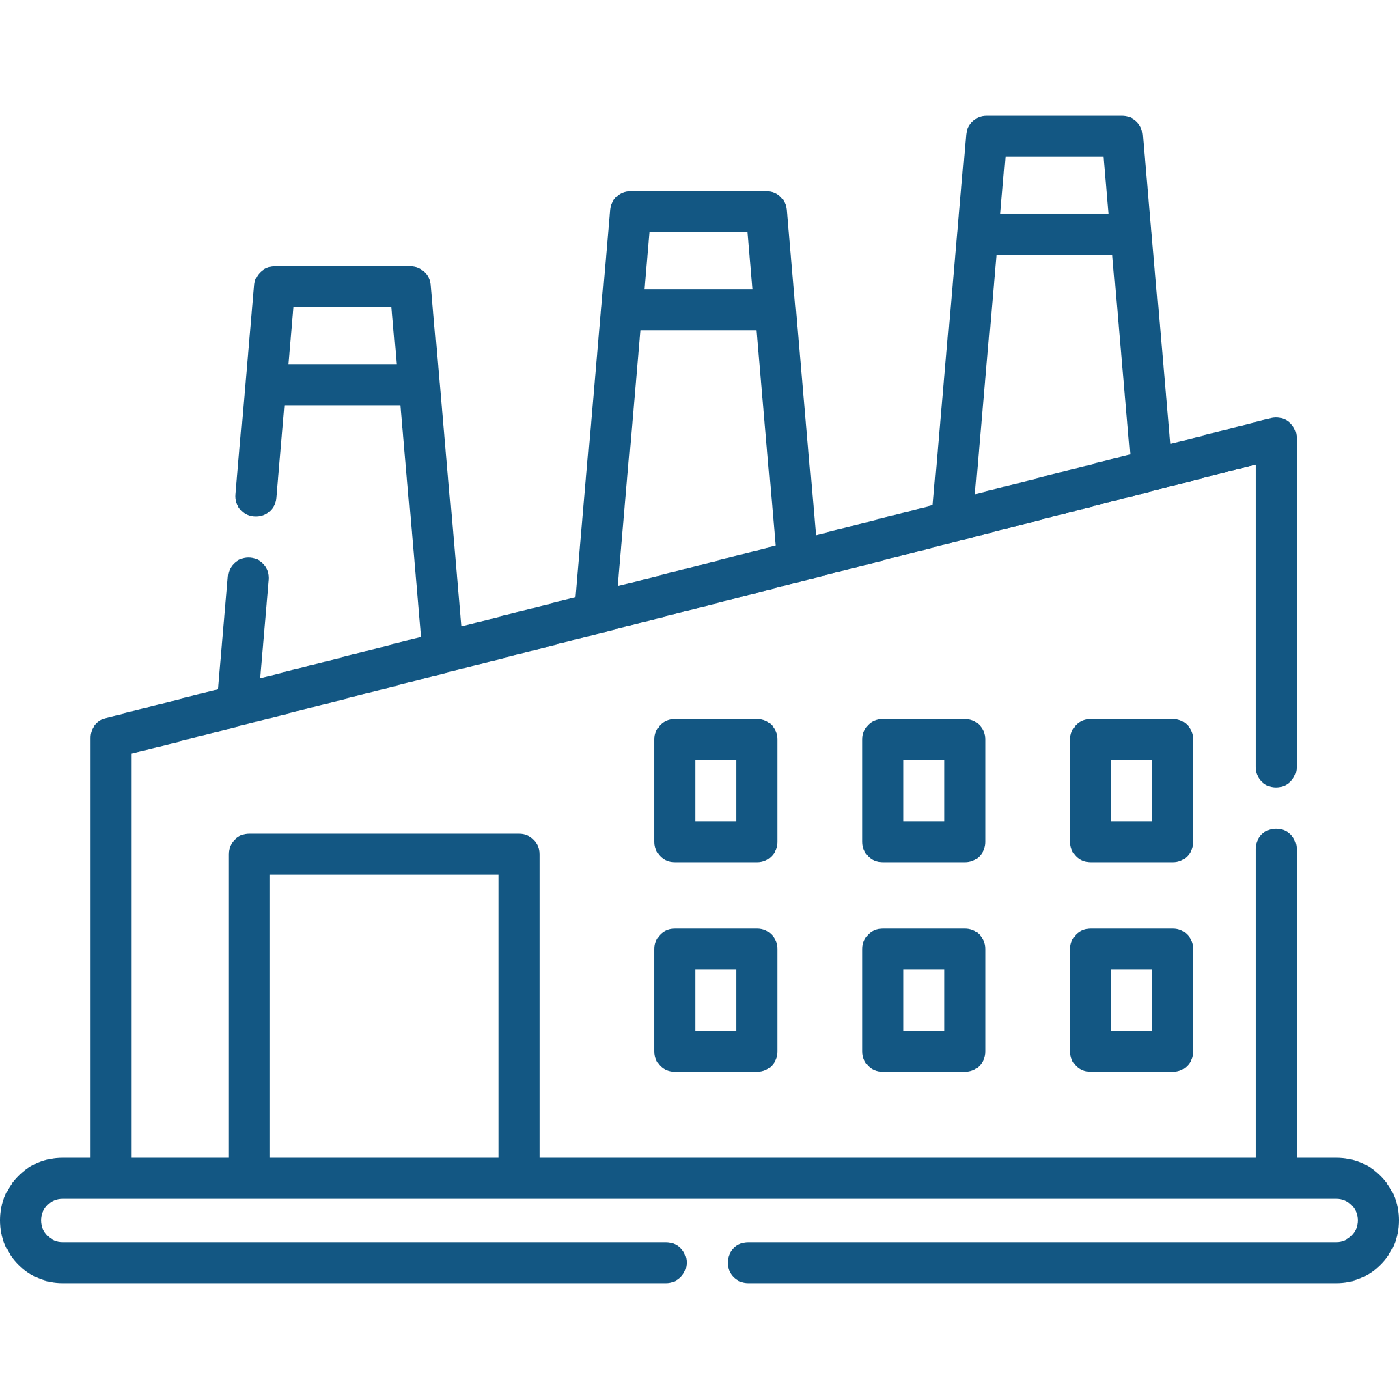
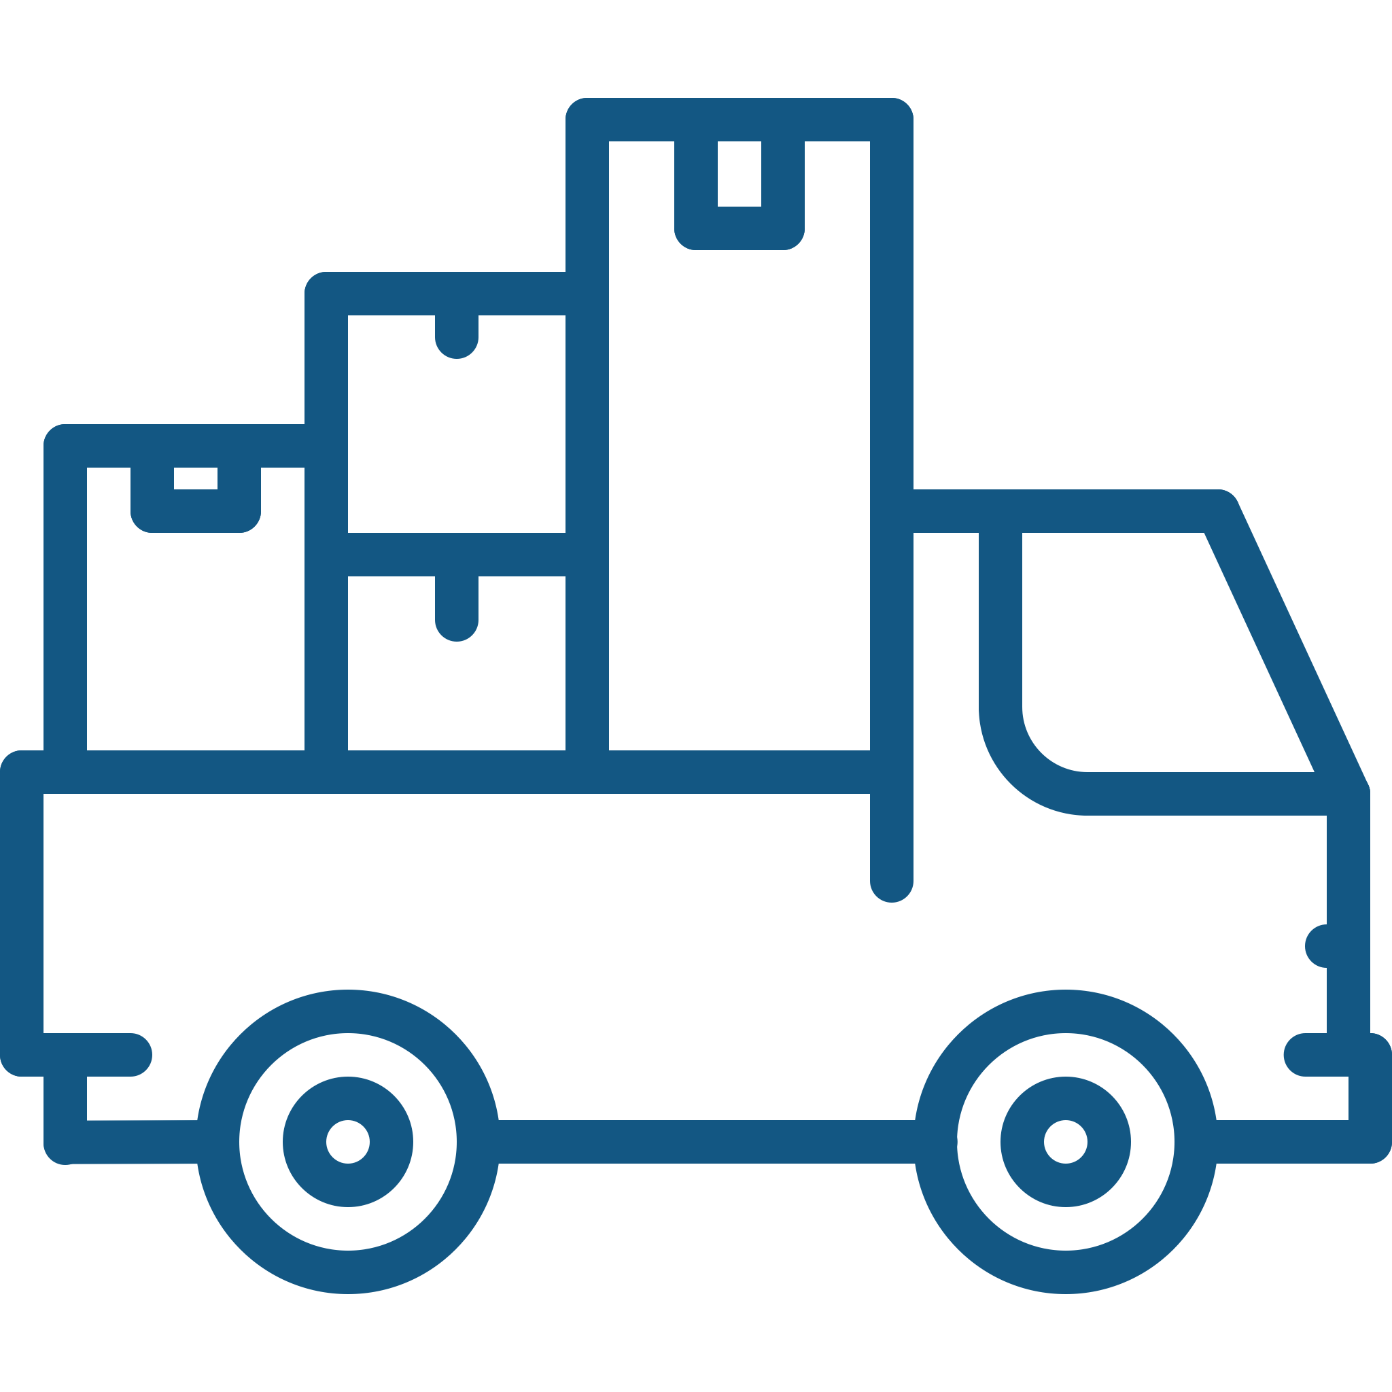

Many large retailers achieve “resilience at low cost” through their internal flexibility
Many large retailers such as Walmart, Amazon or Target have capitalized from their internal flexibility to manage supply or demand disruptions.
They have internal flexible capacities such as trans-shipping goods between different manufacturers or distributors whenever product shortages occur at a single location.
Supplier
Warehouse
Distributor
Customer

Slide 6
Smaller firms can achieve “resilience at low cost” by leveraging across-company commons
Smaller companies can often benefit from across-company commons. These are viewed as pooled resources such as production capacity/ warehousing/ transportation that are shared across firms/industries.
1
2
3
Flexe, DHL and UPS are examples of private third parties that provide e-commerce delivery and storage resources that are shared across competing firms. This allows smaller firms to set up omni-channel solutions.
Commons for smaller firms are often facilitated by the use of technology such as 3D printing
ATM industry: Is there any service that can be outsourced to a third party? This third party (that can still be owned by the various ATM entities) could then offer the service across Europe. This might help increase efficiency and resilience?

Slide 7
Government-sponsored commons
The Strategic National Stockpile (USA) provides supplies of medicines and devices for lifesaving care during public health emergencies. https://www.phe.gov/about/sns/Pages/default.aspx
The petroleum reserve in the USA serves as an emergency source in case of limited supply.
Similar buffers are hold by governments outside of the USA.

Slide 8
Three types of commons
Commons
Economic justification
Level of resilience
In-company
A large company can invest based on improved efficiency for itself
Some resilience to the company at no extra cost
Across-company
A private third party can justify investment based on returns from improved efficiency for client companies
More resilience for client companies, especially small firms
Government
-sponsored
Government can justify investment based on improved efficiency and resilience across industries
Most resilience for companies in multiple industries

Slide 9
Commons for Air Traffic Management?
Disruptions often occur at different locations in Europe.
Can resources be pooled together and shared among the different European stakeholders? Could the creation of a third party be helpful?
What are the regulations?
Could capital be used as a shared resource? All participating organizations pay into a fund on a monthly/yearly basis. Once a disruption occurs, disrupted organizations have access to these funds.
Maybe governments are interested in sponsoring such a common?

Slide 10
Thanks for your attendance!

Slide 11
Many firms need cost-efficient risk mitigation strategies
Firms are often reluctant to implement resilience-enhancing measures.
Implementing risk mitigation strategies often results in a reduction in supply chain efficiency (buffers cost money).
Many firms focus on short-term profitability when creating shareholder value. However, investing in risk mitigation strategies is a long-game (i.e., the investment pays off only in the long-term when disruptions do occur).
Firms often struggle to estimate the likelihood of disruptions to occur because disruptions are considered rare events.

Slide 12
Small firms can achieve “resilience at low cost” by leveraging across-company commons
Smaller companies can often benefit from across-company commons. These are viewed as pooled resources such as production capacity/ warehousing/ transportation that are shared across firms/industries.
1
2
3
Warehousing firm Flexe (www.flexe.com) provides a flexible warehousing common that is particularly helpful for smaller companies
DHL, UPS, and Alibaba are examples of private third parties that provide e-commerce delivery and storage resources that are shared across competing firms. This allows smaller firms to set up omni-channel solutions.
Commons for smaller firms are often facilitated by the use of technology such as 3D printing

Slide 13


Tailored sourcing allows large firms to create some resilience and efficiency
Observe that tailored sourcing results not only in an increase of supply chain efficiency but also
supply chain resilience
Off-shore suppliers provide the benefit of sourcing at low costs.
They are used to serve predictable portion of demand
The near-shore supplier provides the benefit of quickly reacting to changes in costumer demand.
They are used to serve uncertain portion of demand

Slide 14

Tailored sourcing: The practice of using near-shore and off-shore suppliers
It is often used to increase supply chain efficiency and resilience.
If one supplier is disrupted (say the off-shore supplier), the firm can still leverage the other supplier (say the near-shore supplier) to source products

Slide 15




Commons lower the cost of tailored sourcing
Commons help lower costs of
local production.
The flexible manufacturing common is facilitated by using advanced technology
Example: Nike uses flexible manufacturing common to reduce local production costs
Nike produces new and innovative products locally while still sourcing standard products from off-shore

Slide 16
Supply Chain Management
Supply Chain Management is the systemic, strategic coordination of the traditional business functions within a particular company and across companies within the supply chain, for the purpose of improving the long-term performance of the individual companies and the supply chain as a whole.
The goal is to maximize:
Supply chain surplus = Customer value - Supply chain cost
Many firms compete on price, particularly when producing functional products. As a result, there is a high pressure to reduce costs. Supply chain managers aim to increase the efficiency of supply chains. Concepts such as lean manufacturing or just-in time have helped creating supply chain surplus.

Slide 17
Supply Chain Risk Management
Recent events have highlighted to many firms the importance of managing the risk of rare but impactful disruptions in supply chains.
Some ways to manage risk in the supply chain include:
Keeping reserve inventory that can be used in the event of a disruption→ Example Roche Pharmaceuticals
Keeping reserve capacity to build products in case of shortages → Example: Cisco
Near-shoring: moving production closer to the customers→ Example: Zara
Sourcing components from several suppliers → Example: Toyota
These are all meaningful levers in managing risk in the supply chain but come at the cost of a reduced supply chain efficiency.
Supply chain efficiency, which is directed at improving a company’s financial performance, is different from supply chain resilience, whose goal is risk reduction.

